Slide 1

Small Fish, Big Findings:
Using Zebrafish and Genomic Tools to Investigate Nicotine Addiction
Daniela Moura
Class of 2022
Supervisor: Prof Ajay Mathuru

Slide 2
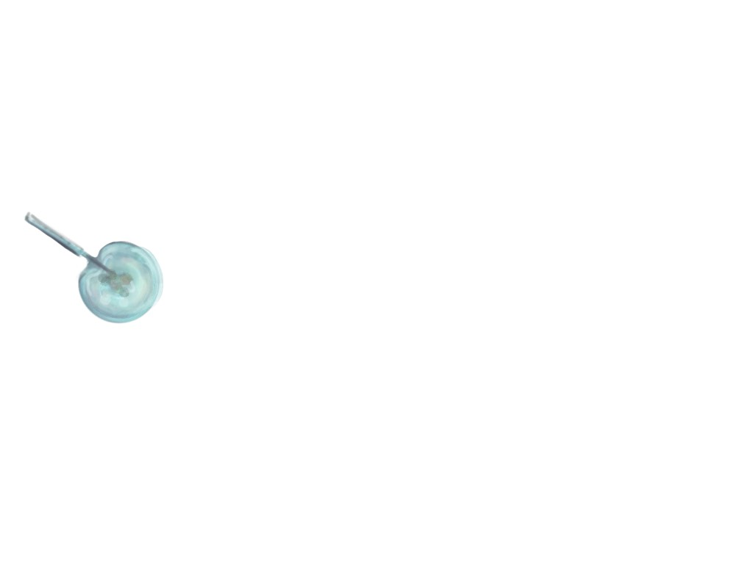


Paintings by Alfred Jason Tai

Slide 3
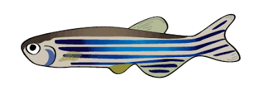
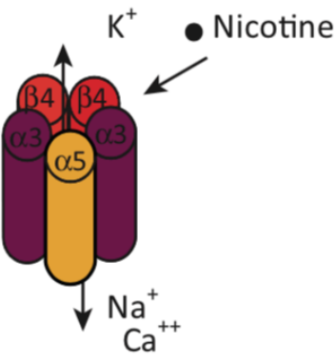
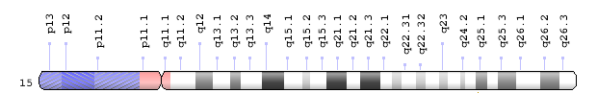
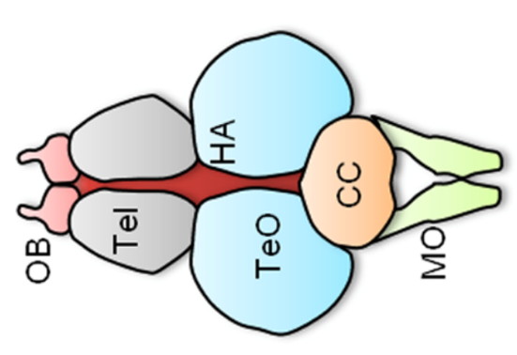
What we investigated
chrna3
Notes:
Addiction has been most succinctly described as the state with an inability to control actions that are pleasurable, but are likely to be detrimental in the long term. (mathuru, 2018, a little rein on addiction)
There had been studies where the role of the other subunits of this receptor (b4, a5) were studied, but not the a3.
top the list of preventable cause of cancer, premature death and economic loss around the world (ibid)

Slide 4
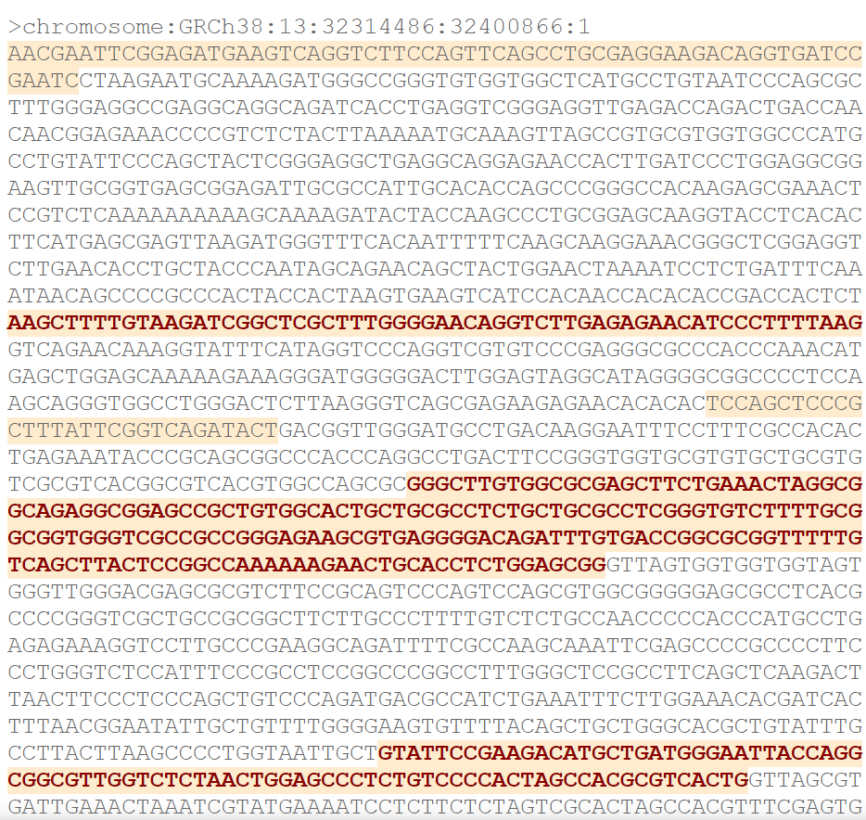

Slide 5
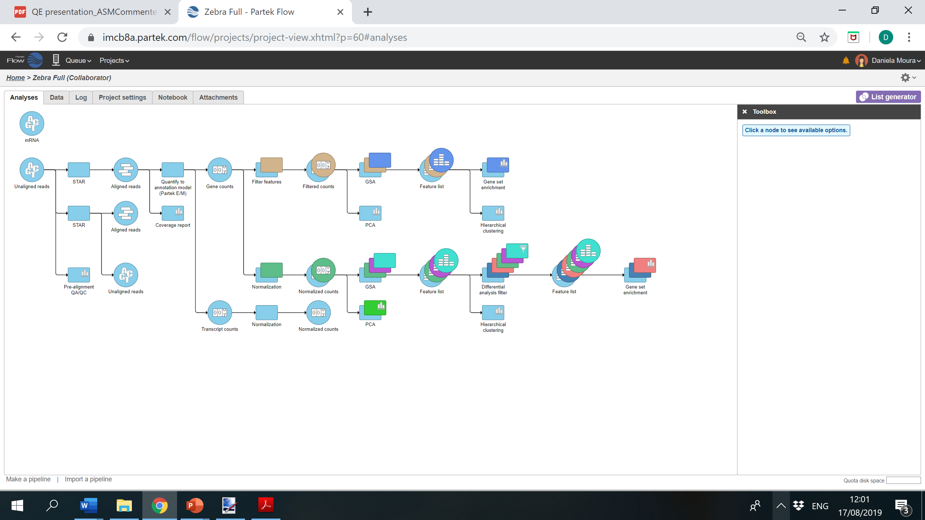


Slide 6
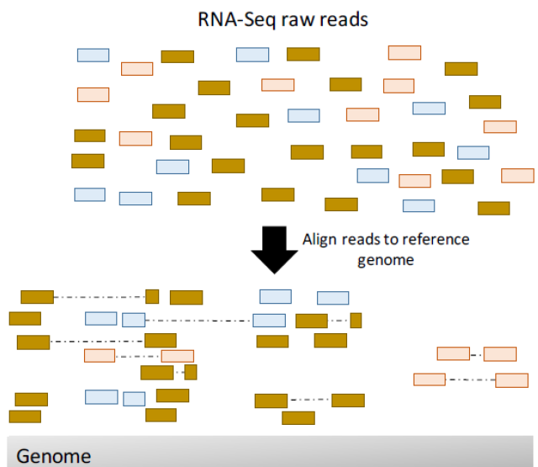

Slide 7
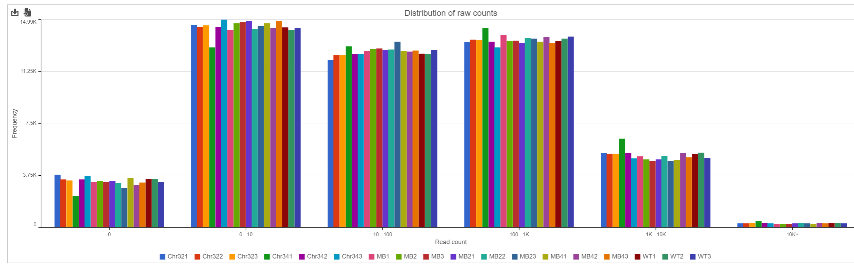

Slide 8
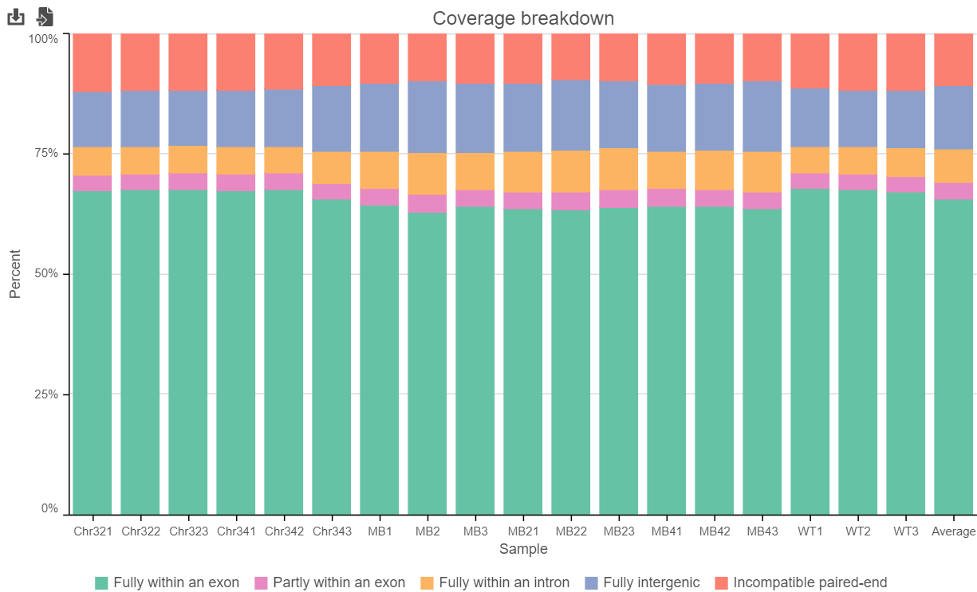

Slide 9
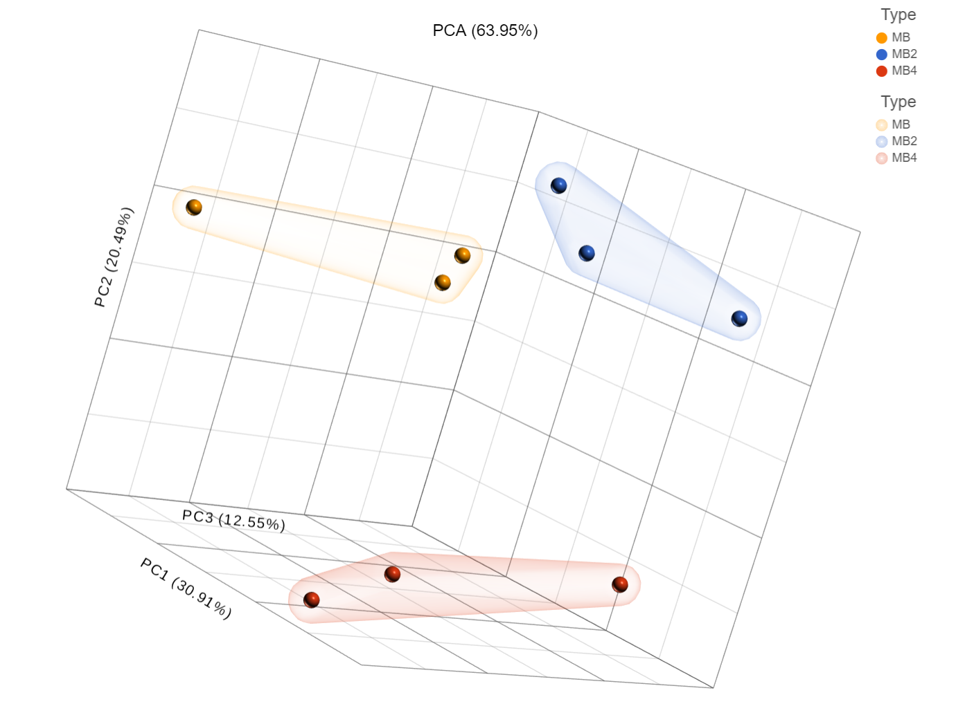

Slide 10
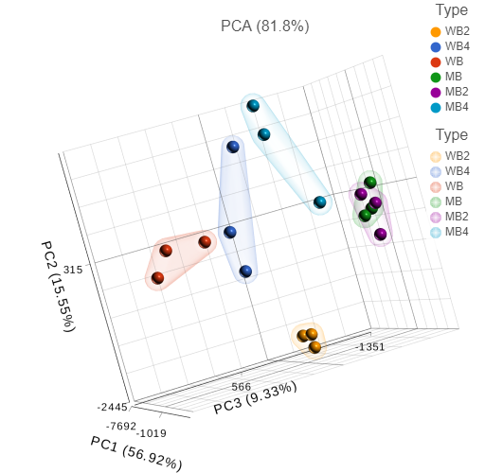

Slide 11
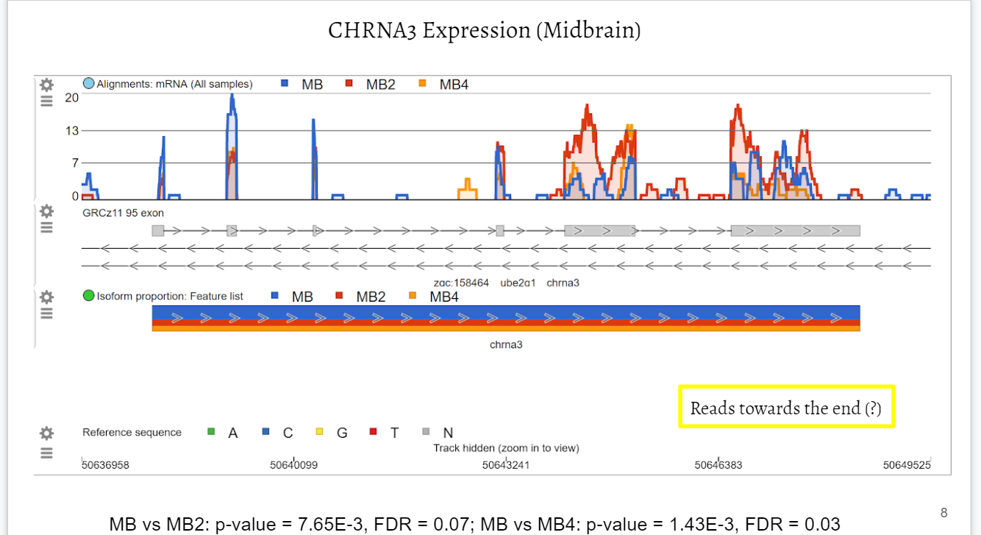

Slide 12
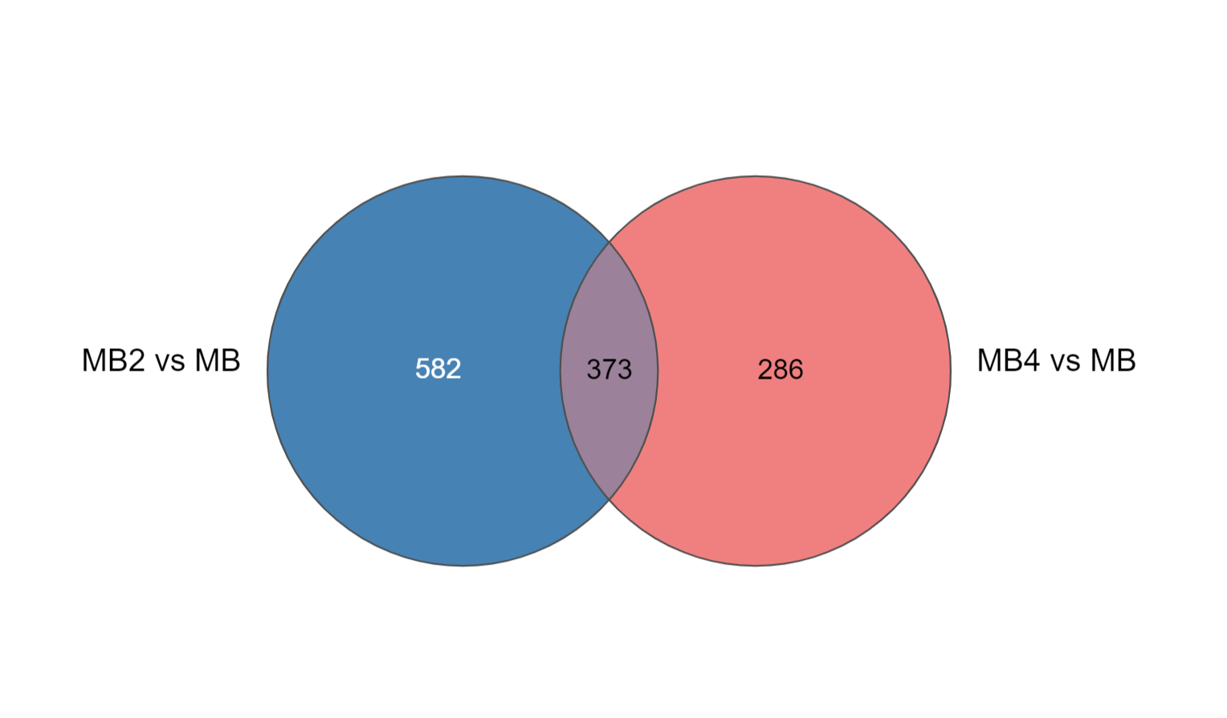

Slide 13
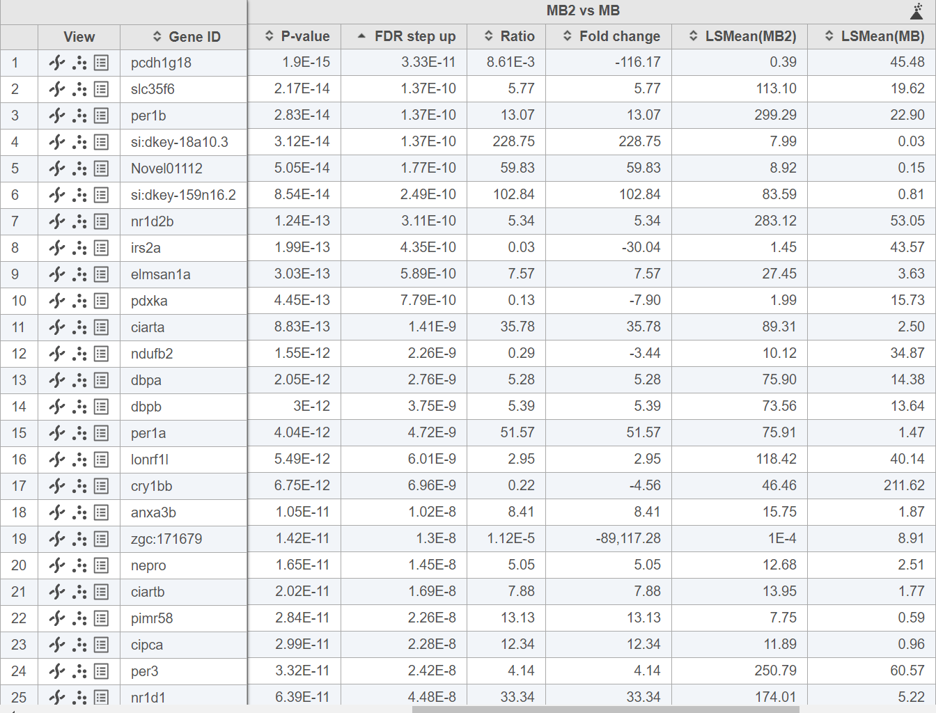

Slide 14
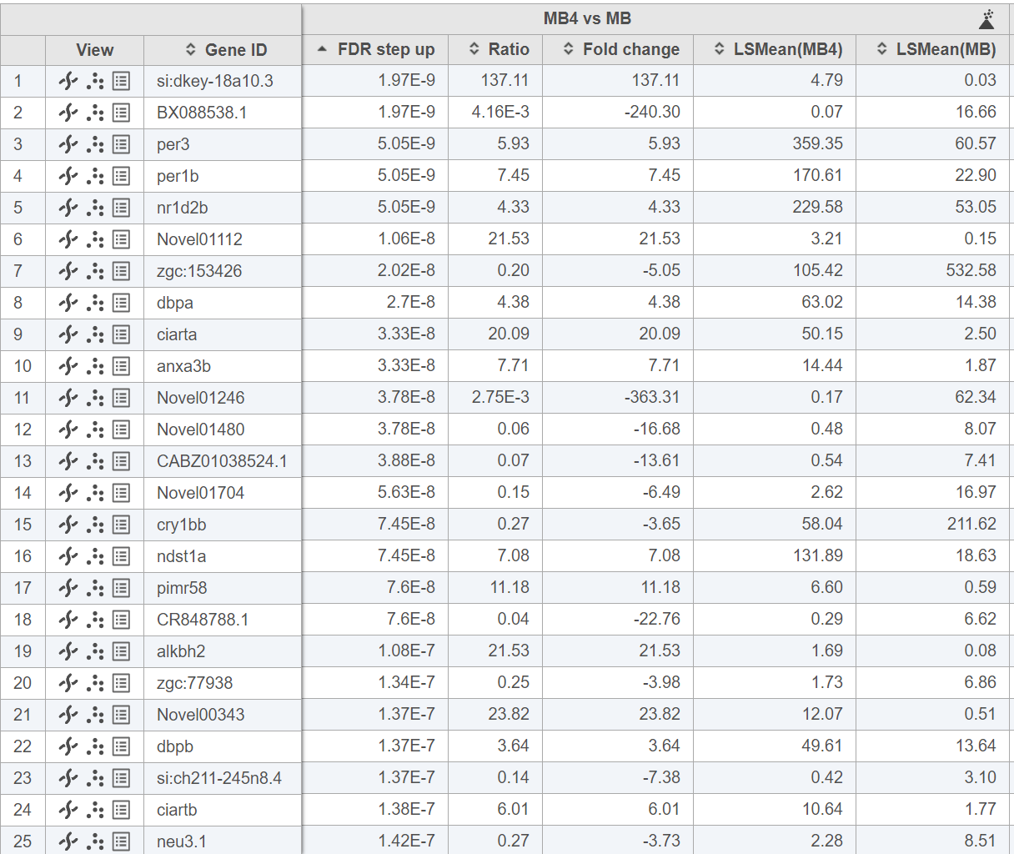

Slide 15
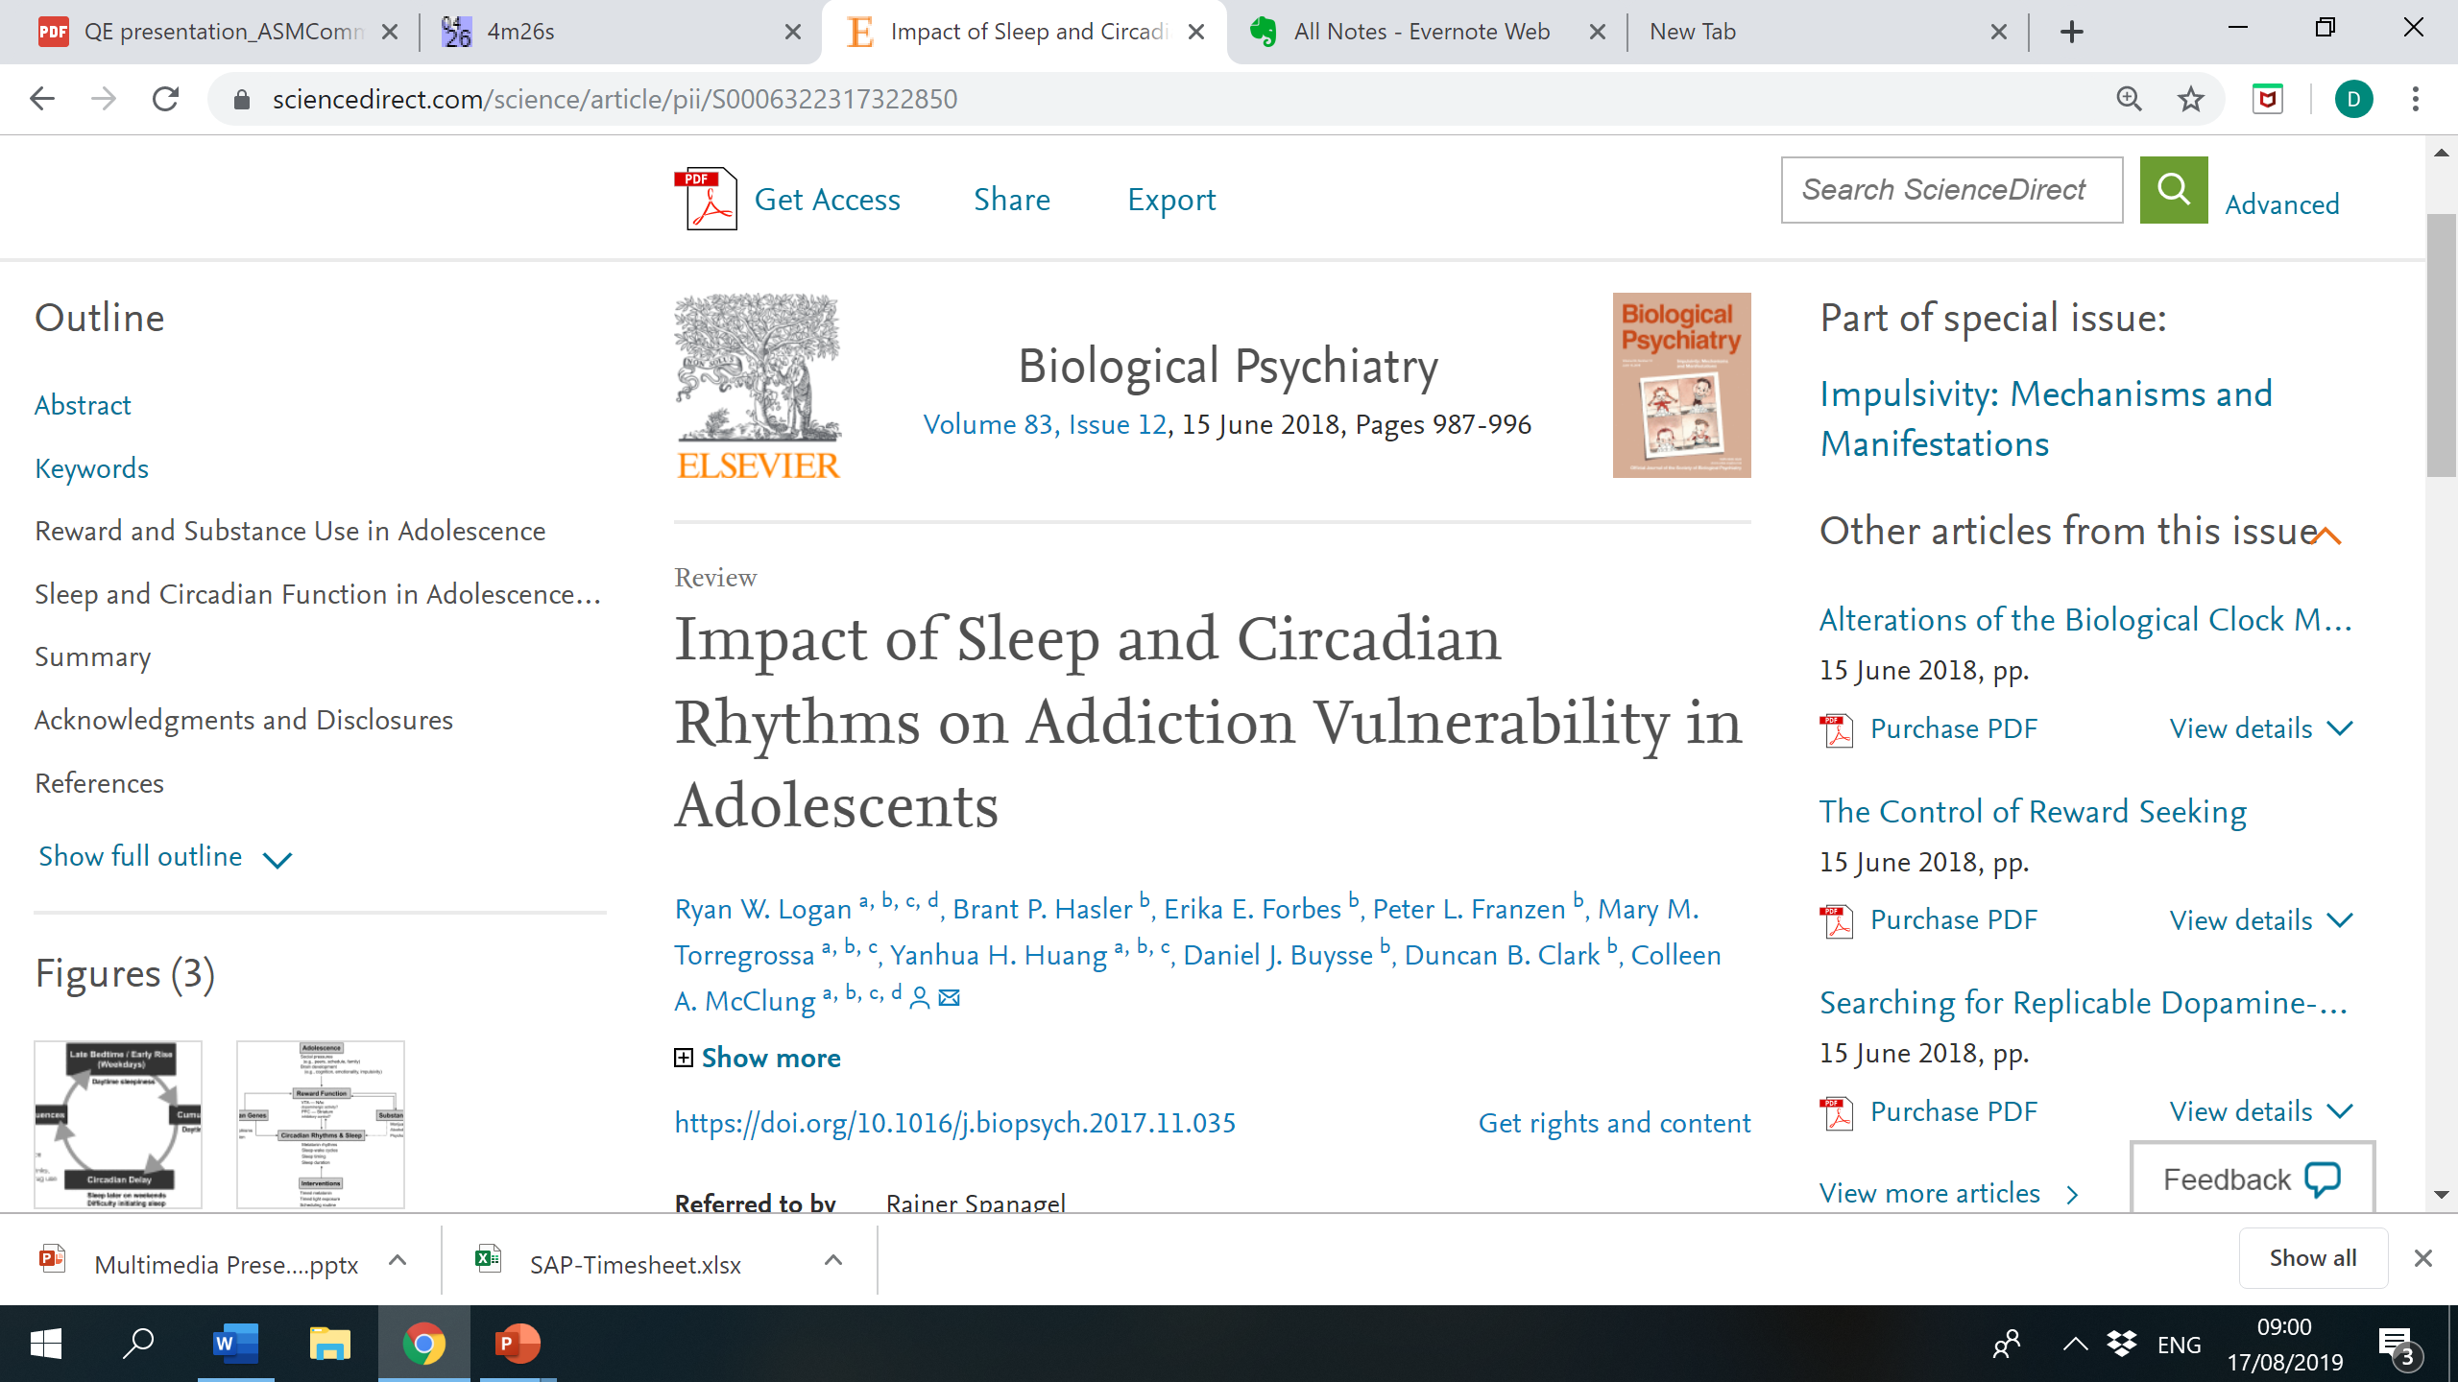

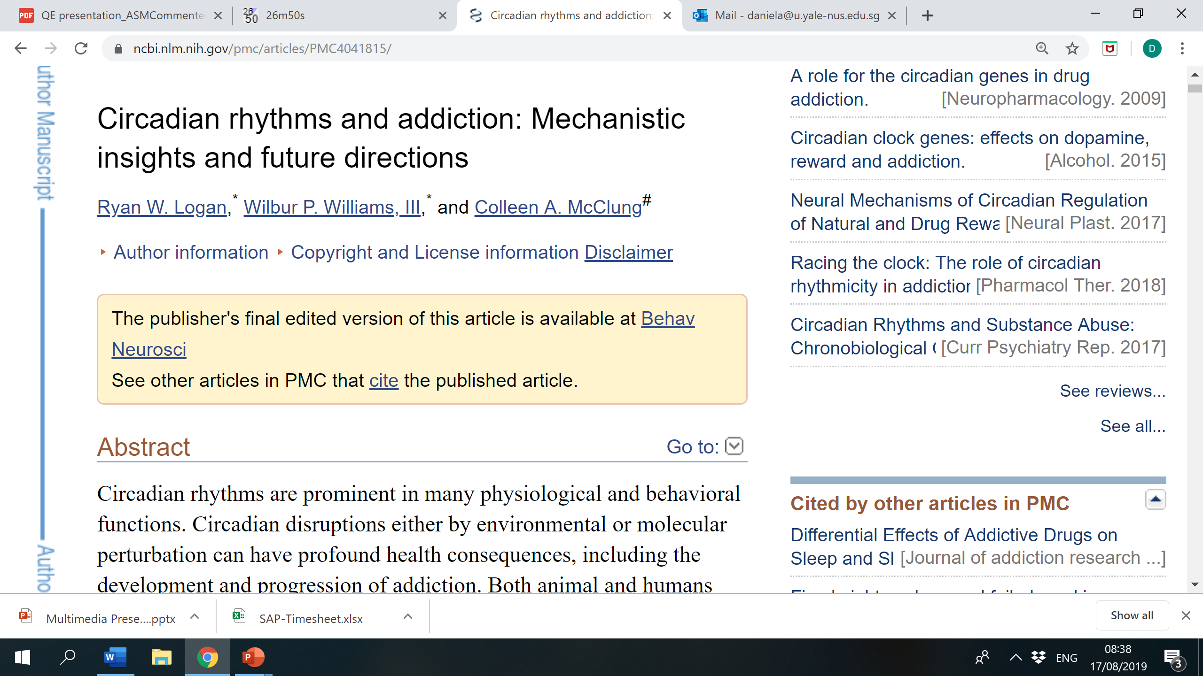
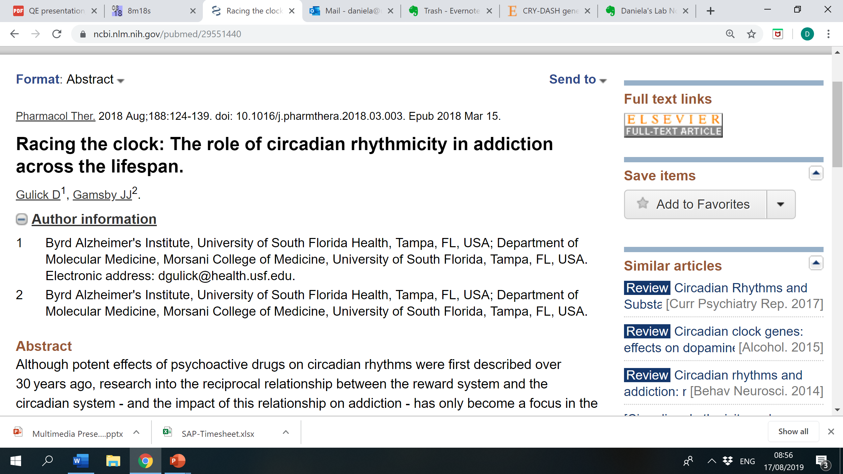
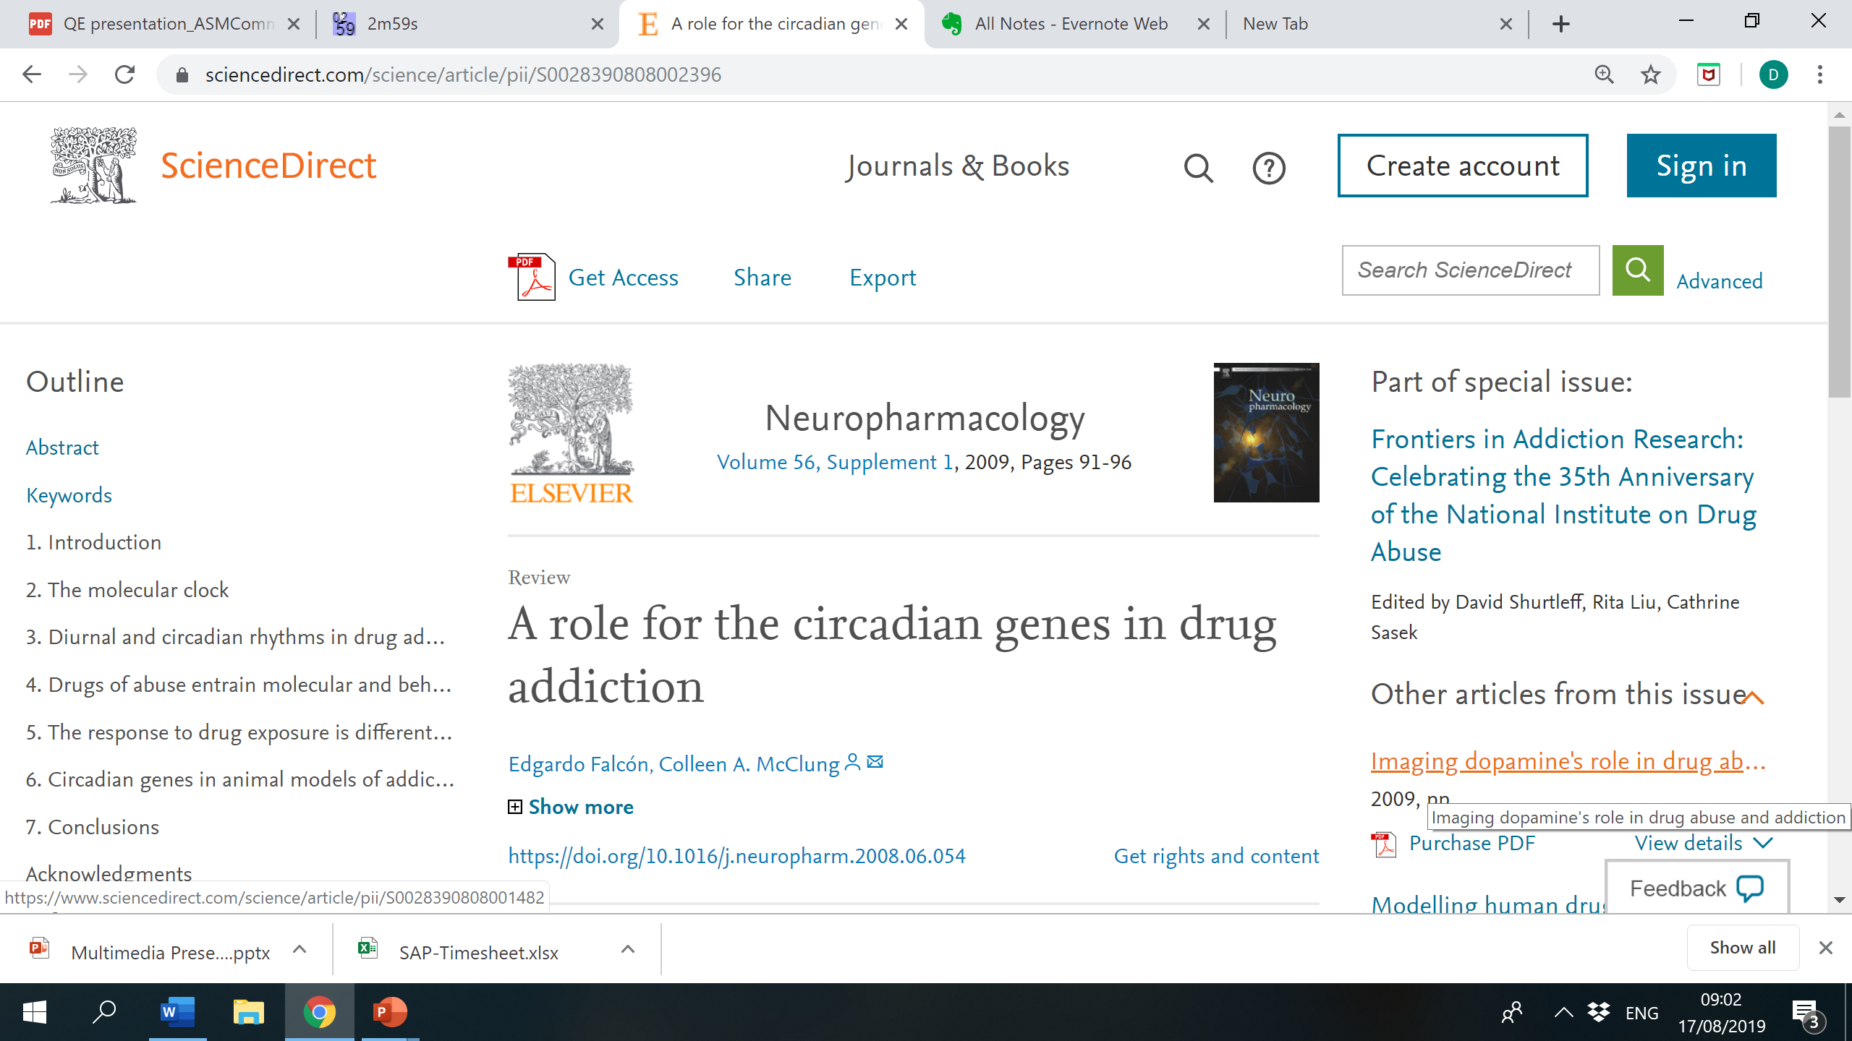
Findings
cry-dash, cry5, cry2, cry1bb
dbpa, dbpb
per1a, per1b, per3
ciarta, ciartb

Slide 16

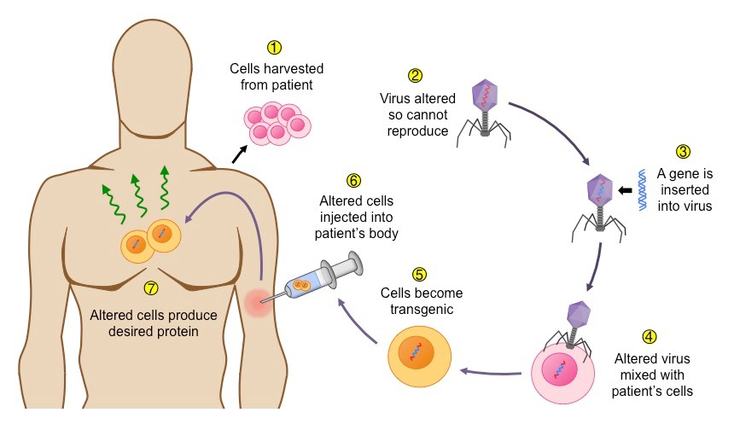
…what do we use all of this for?
Public health
Knowledge!
Gene therapy

Slide 17
Acknowledgments
I would like to extend my most sincere gratitude to:
The JY Pillay Global-Asia Programme for the generous funding
Prof Ajay Mathuru for the incredible guidance and all the yummy snacks
Caroline Kibat, Meg Nathan and Tanisha Goel from the ASM lab for also guiding me in spite of their busy schedules
Lab partners Becca and Rytis for the moral support
Zhana Sandeva and the CIPE team for supporting us throughout

Slide 18
References
Articles:
https://doi.org/10.1016/j.biopsych.2017.11.035
https://doi.org/10.1037/a0036268
https://doi.org/10.1016/j.pharmthera.2018.03.003
https://doi.org/10.1016/j.neuropharm.2008.06.054
Images:
http://zebrafishart.blogspot.com/
https://www.shutterstock.com/image-vector/circadian-rhythms-controlled-by-clocks-biological-1301610571
https://images.app.goo.gl/i4QXAu3iF7qmMMhj9
https://images.app.goo.gl/niGFTyHMhgTVKj257

Slide 19
Thank you!
Feel free to ask me any questions now or contact me at
daniela@u.yale-nus.edu.sg

Slide 20
Abstract
Recent technological developments have greatly impacted how research in the life sciences is interpreted, enabling more efficient and objective analysis of results. This project aimed at optimising the data analysis of experiments on nicotine addiction, primarily through python scripts and the genomic analysis software Partek Flow. We used Partek Flow to investigate DNA-level differences between wild type zebrafish and zebrafish that showed higher nicotine preference due to a mutation on a gene (chrna3) that codes for a nicotine receptor subunit. These differences may provide us with some insight into potential genetic correlates for nicotine addiction. Three hundred and seventy-three genes were found to be differentially expressed in the midbrain of mutants when compared to the same brain region of wild type zebrafish (FDR-adjusted P value < 0.05, fold change > |2|). Circadian rhythm genes were amongst the most differentially expressed, which concurs with existing research on genes correlated with nicotine addiction. However, novel genes were also identified within this group. Knowing which genes are correlated with nicotine addiction may provide potential molecular targets for pharmacological interventions and help public health practitioners optimise resources by creating prevention campaigns targeted at risk groups.

Slide 21
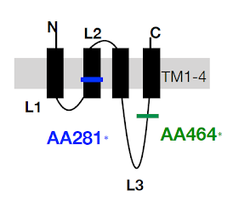

Slide 22
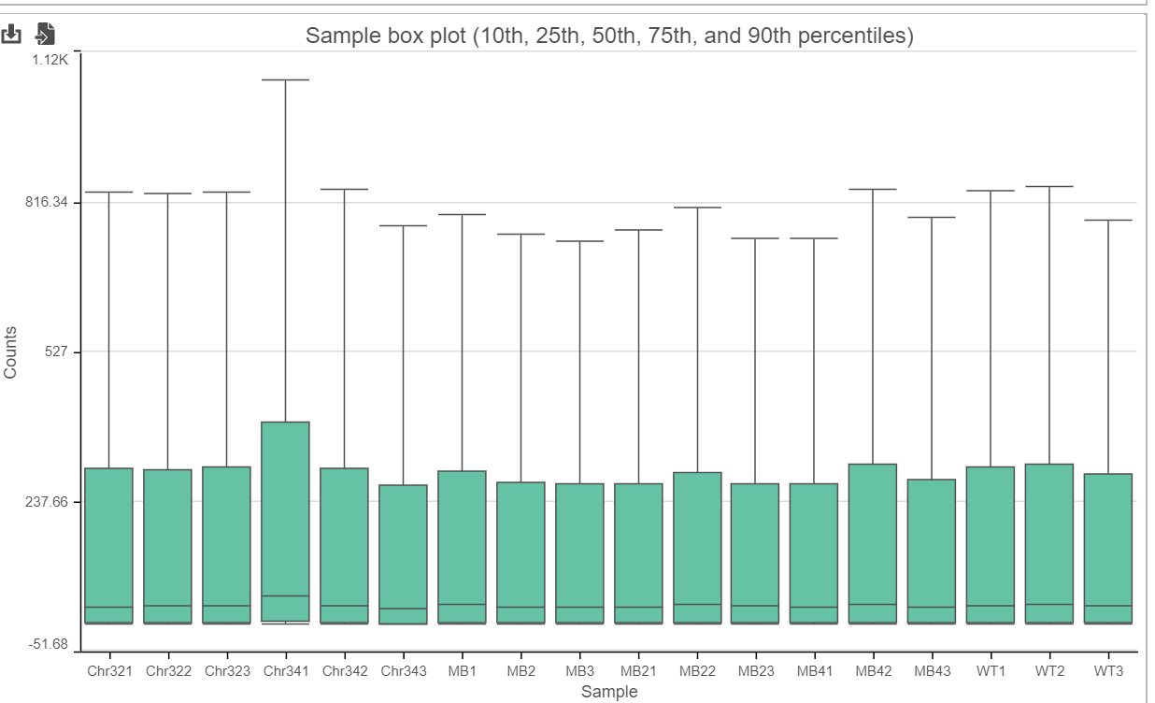

Slide 23
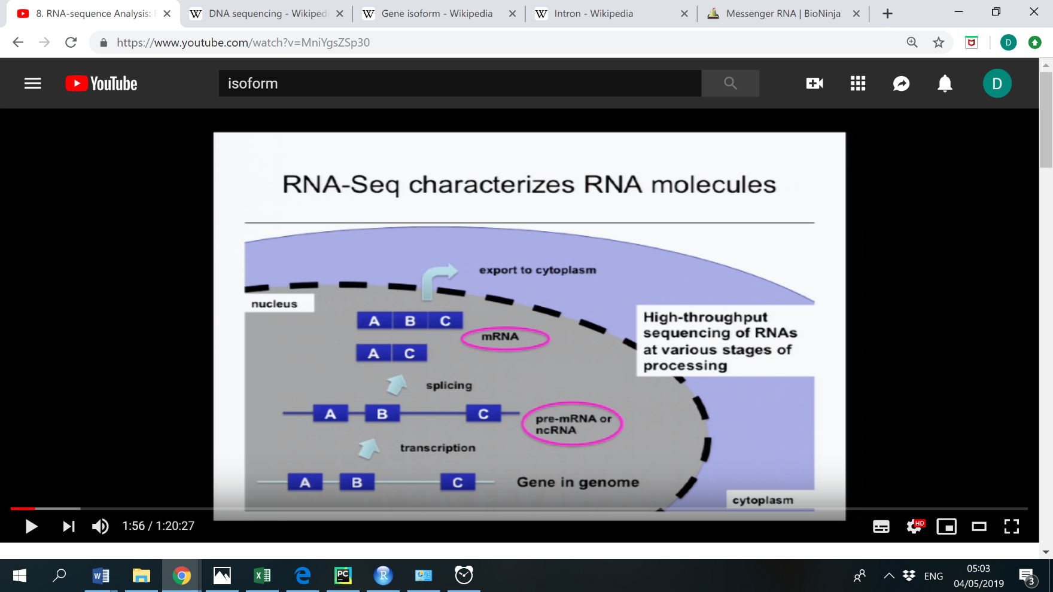

Slide 24
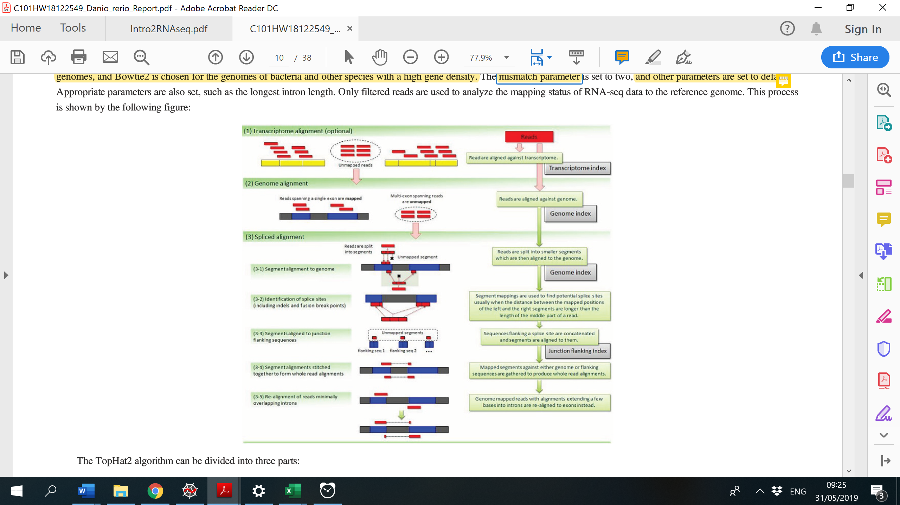

Slide 25
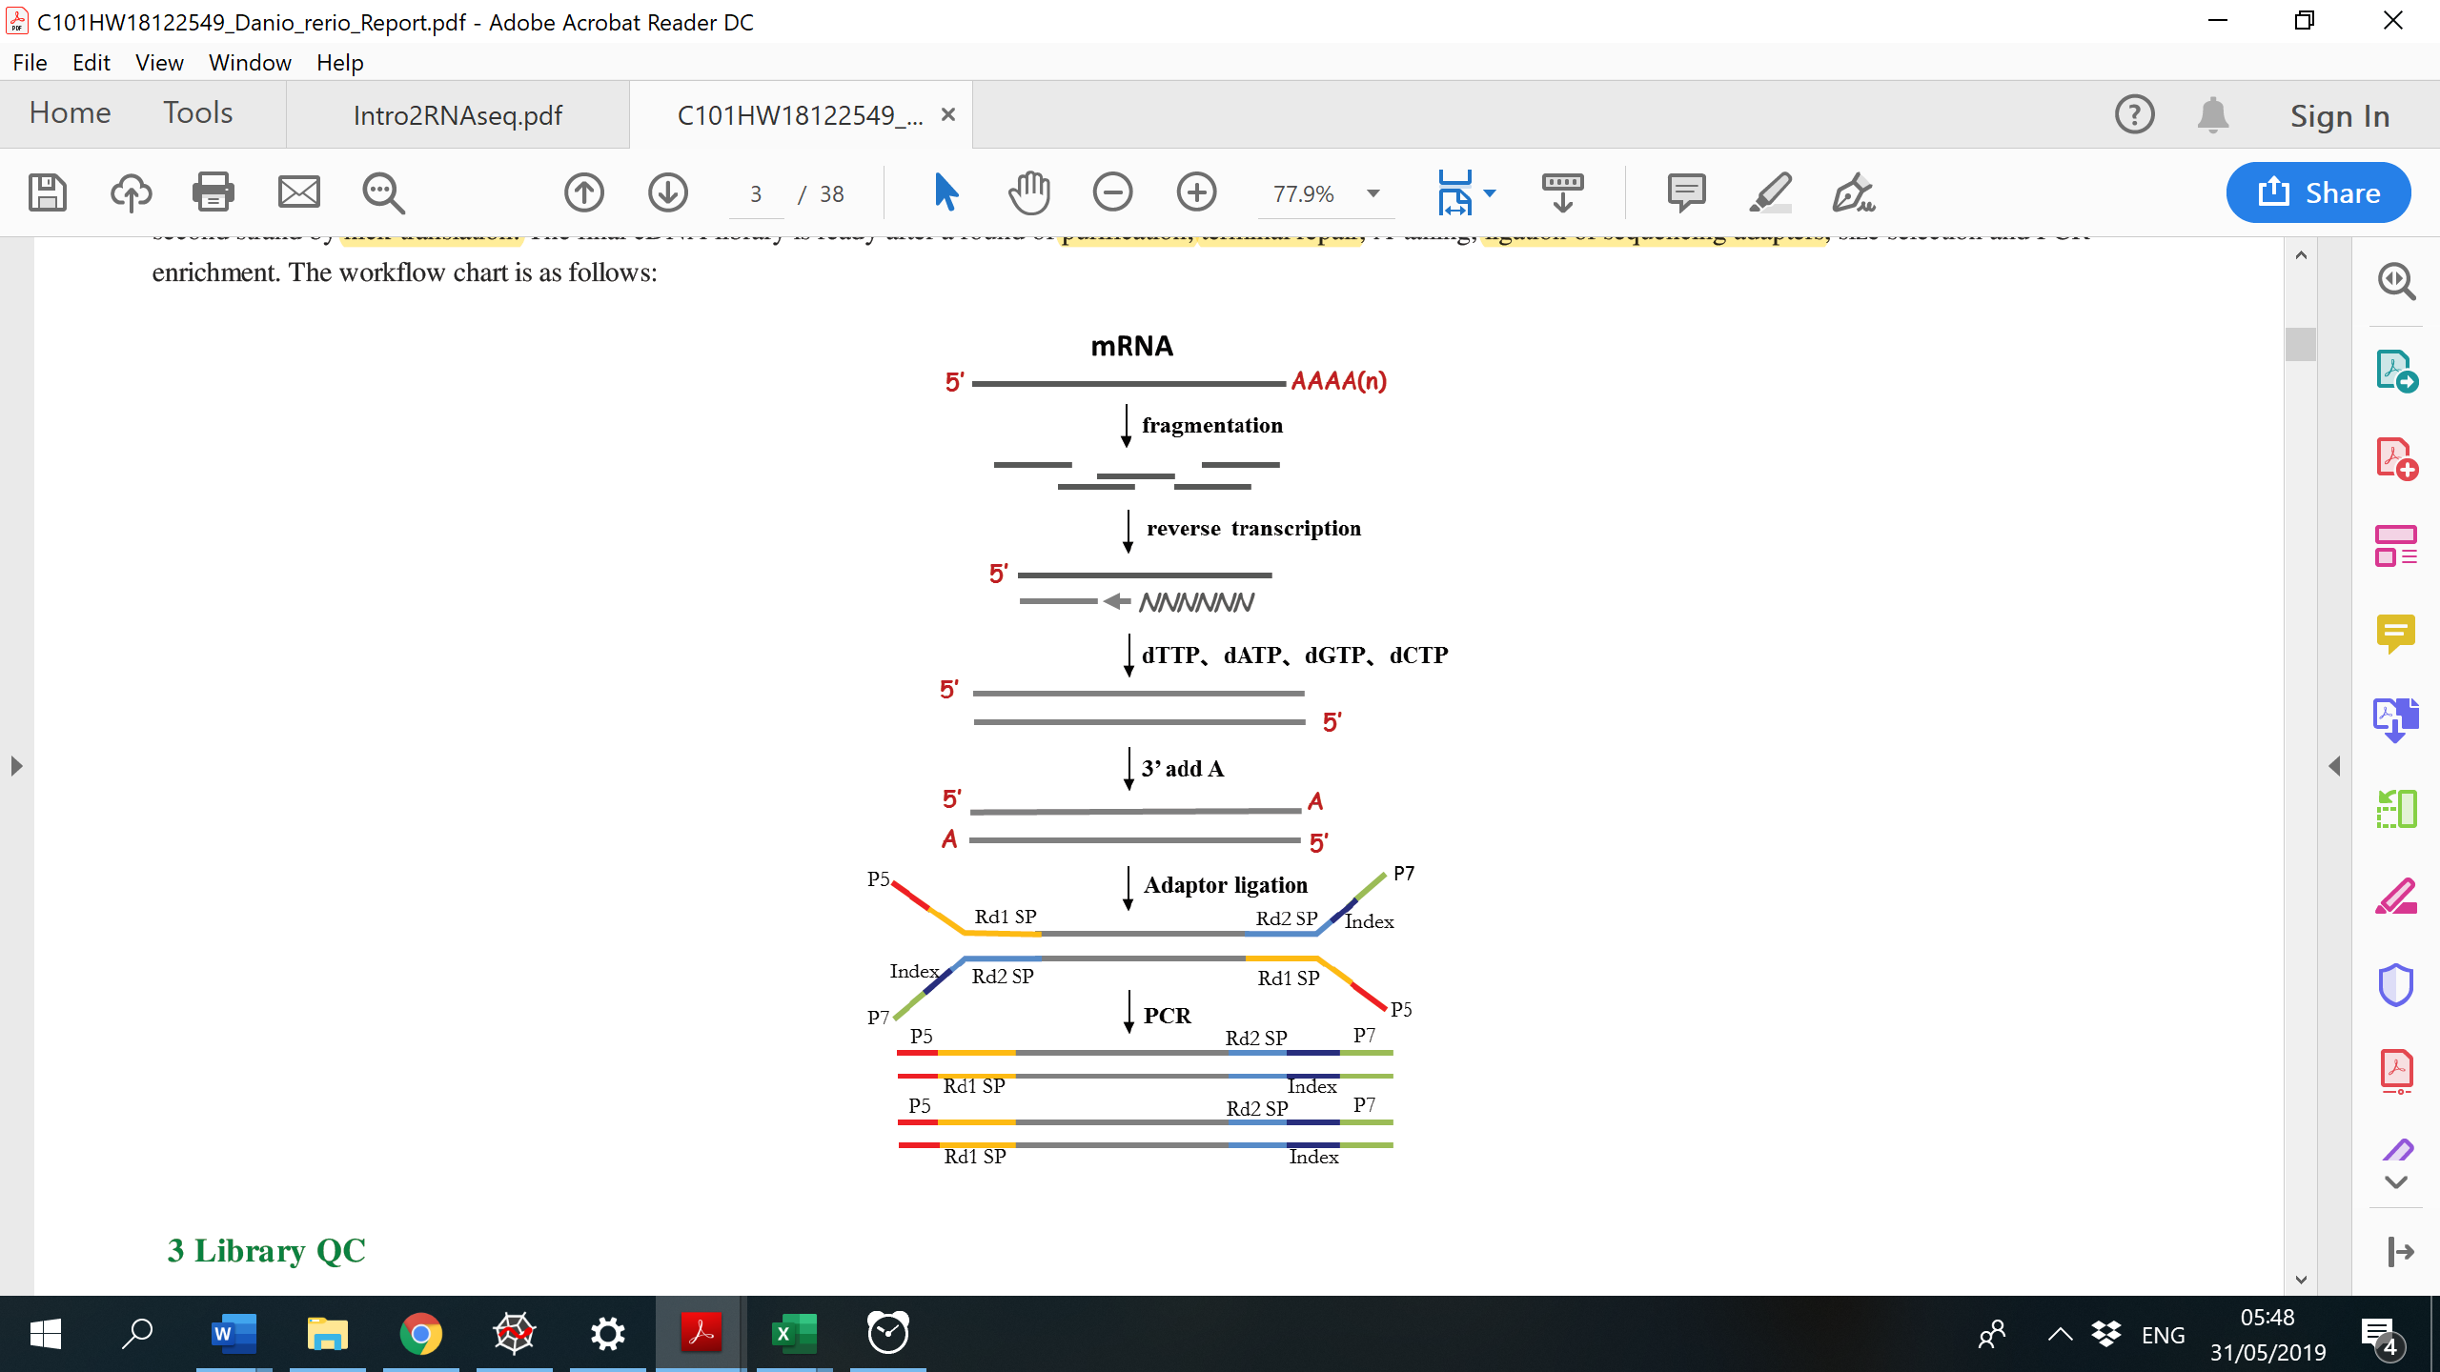

Slide 26
